Slide 1
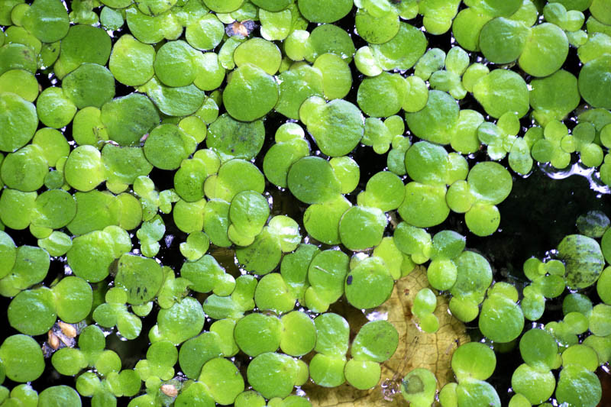
Lemna population growth!
Population and community ecology lab #2
K. Schroeder – 10/2023

Slide 2
Learning objectives for today
Make predictions on how an environmental variable will affect population growth
Set-up an experiment to test for differences in population growth rate and carrying capacities for the growth of a freshwater plant under different environmental conditions
Notes:
Bioremediation: heavy metals like lead, copper, zinc, arsenic removed efficiently from waters with nonlethal concentrations
Livestock feed: high protein content (20-40%), low fiber. Good fodder for fish and poultry. Also used for feeding ducks
Biofuel: can be used for bioethanol production
Ecotox: used to assess toxicology of wastewater and landfill leachates

Slide 3
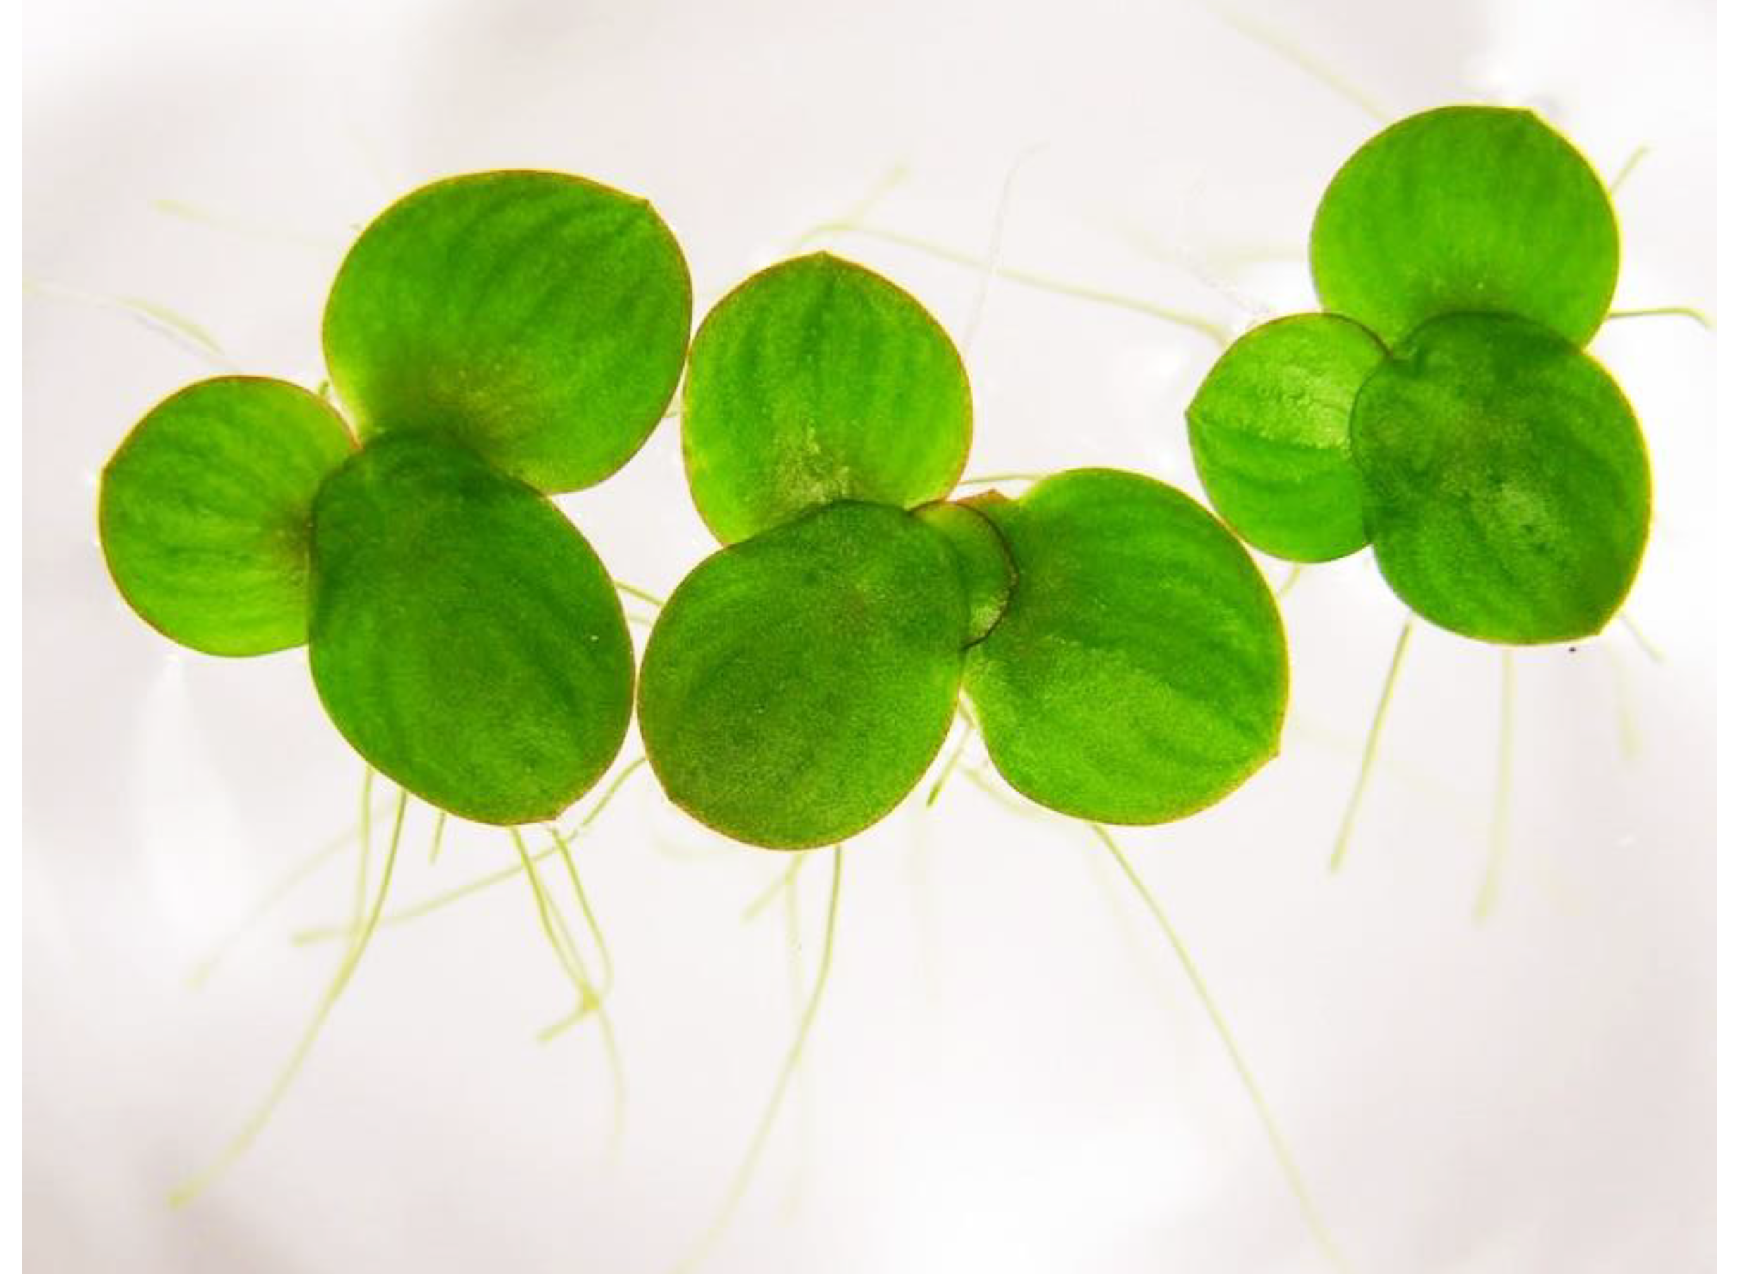
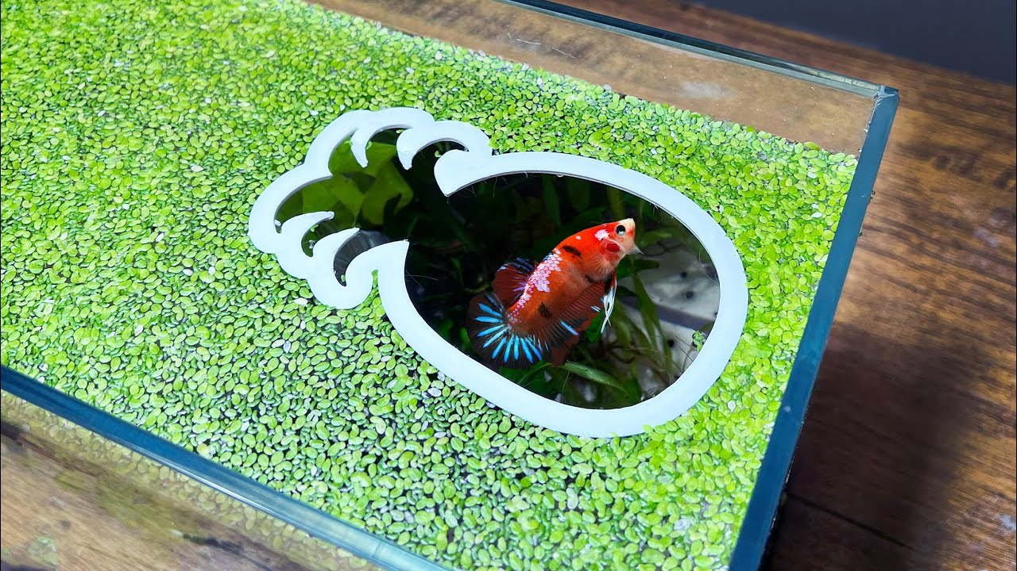
What is Lemna?
https://www.mdpi.com/2223-7747/12/11/2134
Lemna minor
Also called common duckweed or lesser duckweed
Common freshwater aquatic plant
Used for bioremediation, as livestock feed, as biofuel, in ecotoxicology studies, as an aquarium plant
https://www.youtube.com/watch?v=hZDr0OuiVcQ&ab_channel=AquariumInfo
Notes:
Bioremediation: heavy metals like lead, copper, zinc, arsenic removed efficiently from waters with nonlethal concentrations
Livestock feed: high protein content (20-40%), low fiber. Good fodder for fish and poultry. Also used for feeding ducks
Biofuel: can be used for bioethanol production
Ecotox: used to assess toxicology of wastewater and landfill leachates

Slide 4
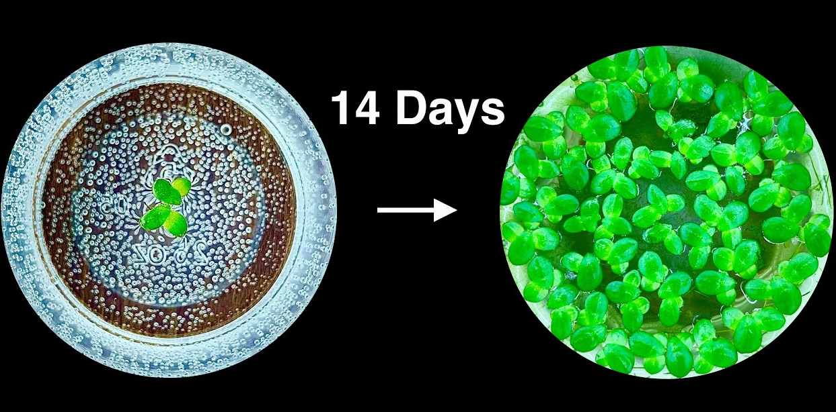
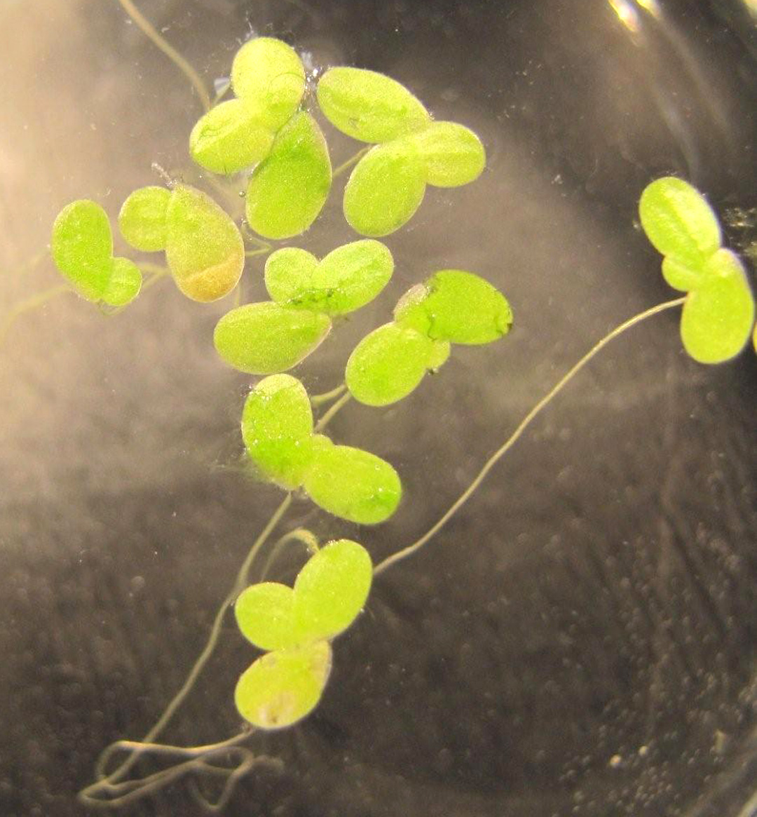
How does Lemna grow?
1-4 leaves (thalli) per plant
1 single root
As Lemna grows, each plant adds leaves and then divides to form multiple plants
https://www.youtube.com/watch?v=EGVtRANdgkw&ab_channel=AquariumPlantLab
https://redoubtreporter.wordpress.com/2010/11/03/science-of-the
-seasons-simple-plant-has-place-in-complex-web/

Slide 5
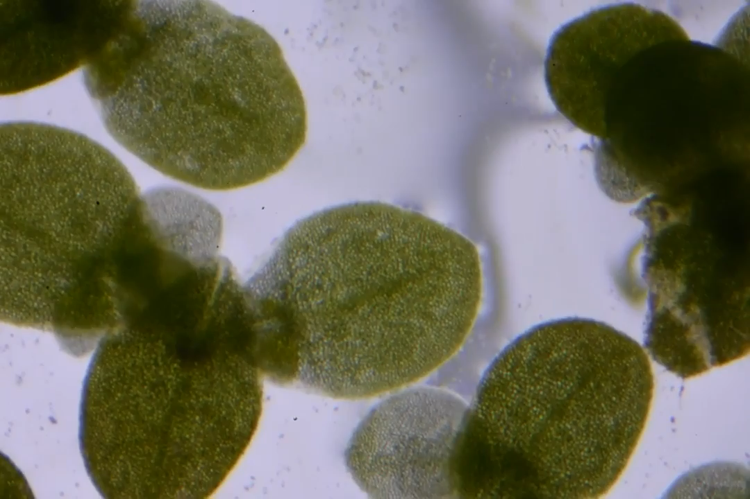
How does Lemna grow?
https://www.youtube.com/watch?v=ypvraB3lNVY&ab_channel=Ran.glacialis

Slide 6
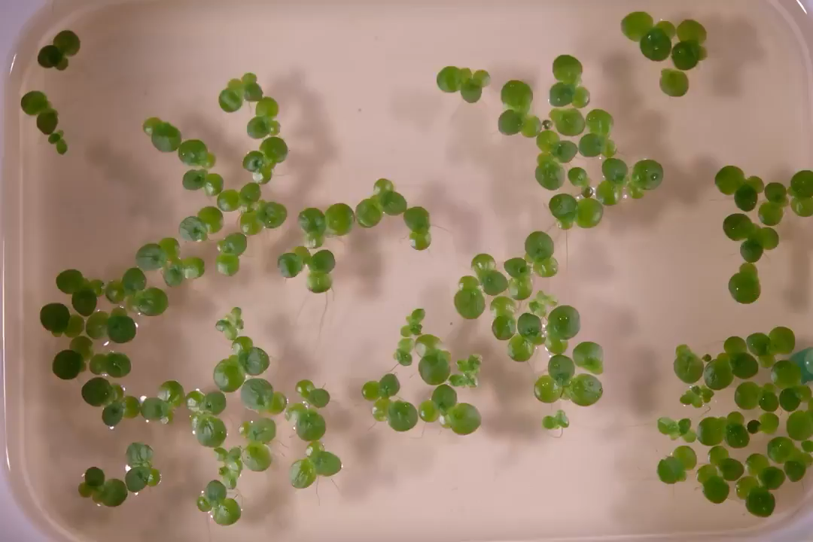
How does Lemna grow?
https://www.youtube.com/watch?v=U0f4n8zRg14&ab_channel=Ran.glacialis

Slide 7
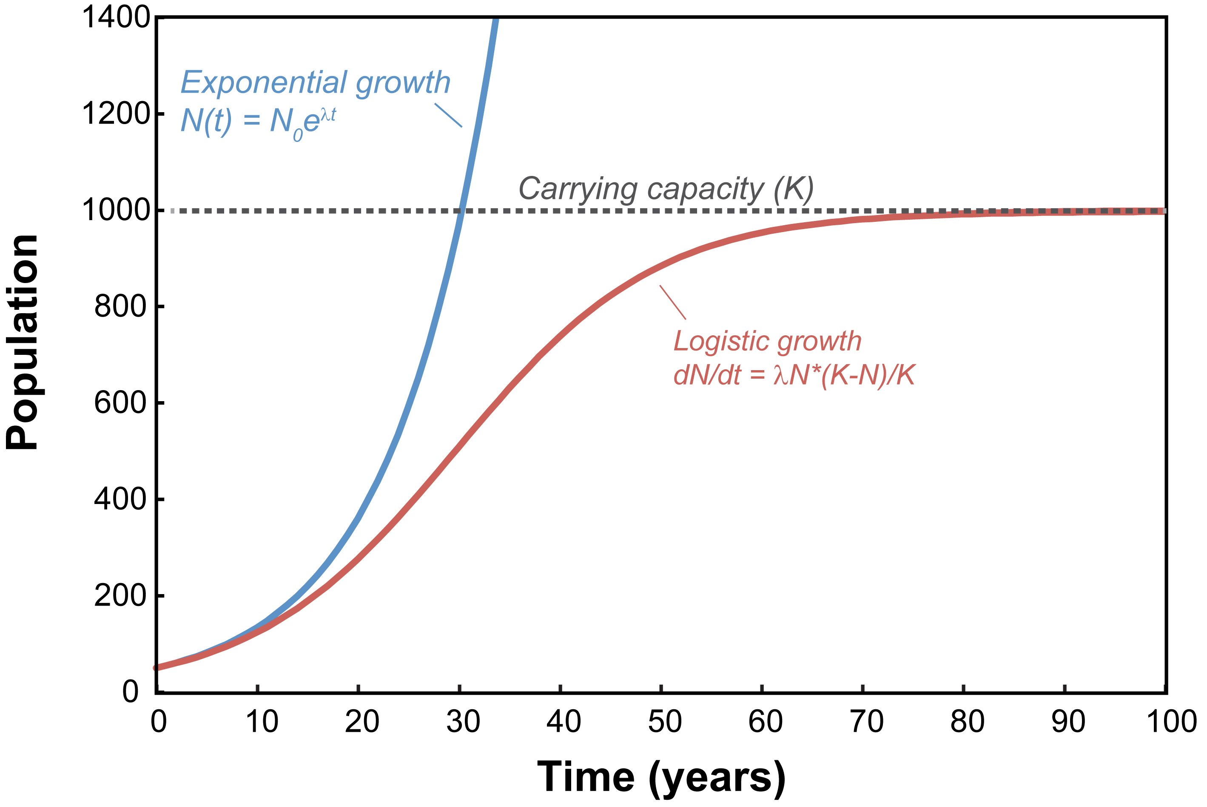
Today’s lab
You will be measuring Lemna population growth by counting the number of individuals over time under different conditions
Counting Lemna every
1-2 days for 3 weeks
https://serc.carleton.edu/details/images/56878.html
Notes:
Experimental treatments:
Nutrient addition
Light availability
Initial density
Surface area
Design your own

Slide 8
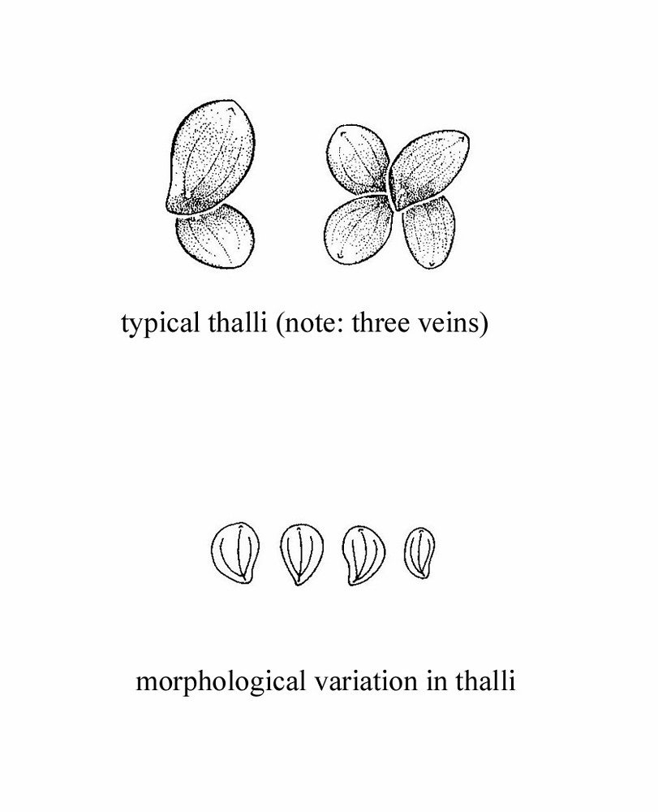
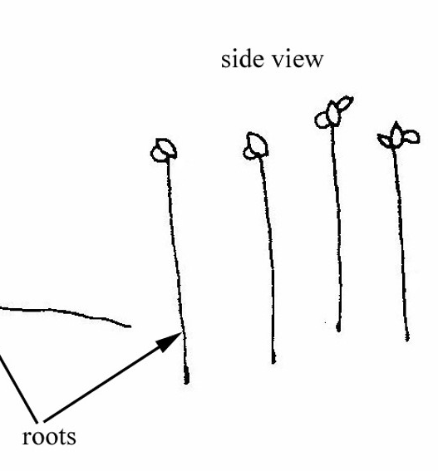
Collecting Data: Parts of Lemna
The ‘leaves’ on Lemna are called thalli (singular: thallus)
https://redoubtreporter.wordpress.com/2010/11/03/science-of-the
-

Slide 9
Designing your experiment
Each group will be designing an experiment to ask a couple questions:
1. Does Lemna minor grow exponentially or logistically?
2. Do environmental variables affect the growth rate and carrying capacity (if applicable) of Lemna minor?
You can have up to 15 experimental replicates
Recommended designs:
3 treatments with 5 replicates each
5 treatments with 3 replicates each

Slide 10
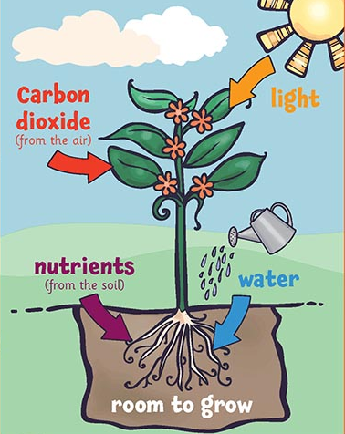
What plants need to grow review
https://www.cgpplus.co.uk/primary/ks2/science/s2wae55-what-plants-need-to-grow-poster-year
Notes:
Sunlight
CO2
Water
Nutrients
Also could have room to grow (space) as an answer

Slide 11
What plants need to grow review
Sunlight
CO2
Water
Nutrients
Room to grow (space)
Another option: starting density
https://www.cgpplus.co.uk/primary/ks2/science/s2wae55-what-plants-need-to-grow-poster-year
Notes:
Sunlight
CO2
Water
Nutrients
Also could have room to grow (space) as an answer

Slide 12
In your groups:
Pick one of these things (or brainstorm your own) to vary for your experiment
You can have up to 15 populations
Recommended designs:
3 x 5
5 x 3
Check your design with me and then start adding growth medium to your containers
Make sure to label each of your containers with the replicate name and a unique ID for your group
Sunlight
CO2
Water
Nutrients
Room to grow (space)
Another option: starting density

Slide 13
Collecting and analyzing data

Slide 14
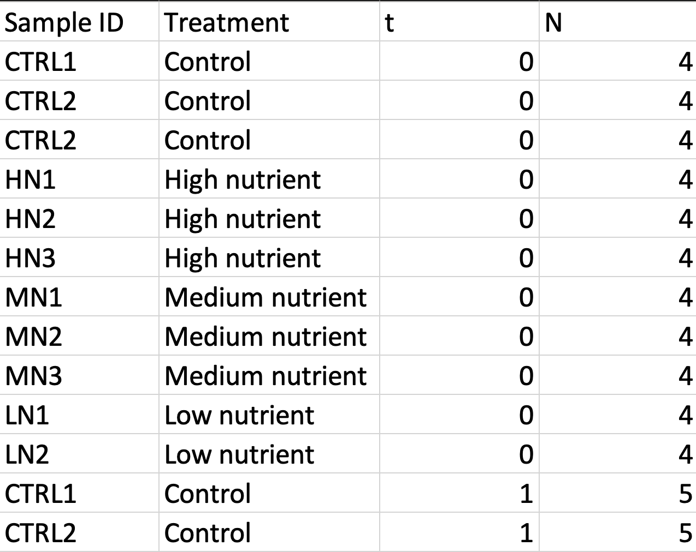
Collecting Data:
Set up a shared spreadsheet for your group – Google Sheets are a good option
See the example datasheet on the eLC page for setting up your sheet

Slide 15
Analyzing data
You will be graphing your data as the population over time
From this population over time data, we can determine if the population is growing logistically or exponentially

Slide 16
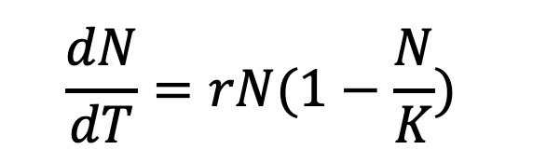
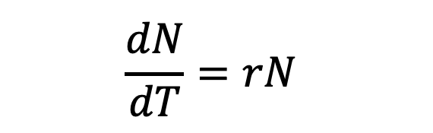
Population growth review
$$\frac{dN}{dT}=rN$$
$$\frac{dN}{dT}=rN(1−\frac{N}{K})$$
https://serc.carleton.edu/details/images/56878.html
Notes:
Match exponential vs logistic

Slide 17
Before you go:
Make sure you have labeled all of your experiment containers
Set up a group spreadsheet and record your day zero data
Turn in the experimental design sheet to eLC

